Slide 1
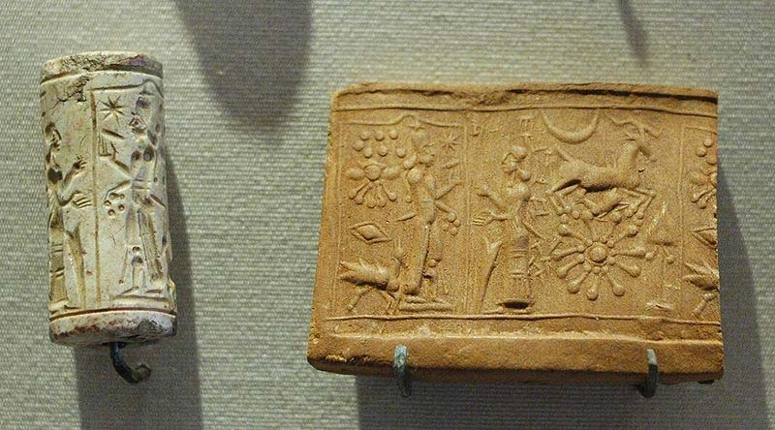
Sumerian Cylinder Seals and Cuneiform Tablets
A social studies integrated ceramic art project for grades 5 and up
Donna Pence

Slide 2
A cylinder seal is a cylinder engraved with a 'picture story', used in ancient times to roll an impression onto a two-dimensional surface, generally wet clay. Cylinder seals were invented around 3500 BC in the Near East, at the contemporary site of Susa in south-western Iran and at the early site of Uruk in southern Mesopotamia. They are linked to the invention of the latter cuneiform writing on clay cylinders.

Slide 3
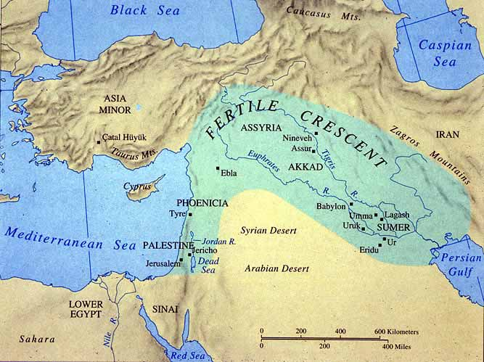
Uruk
Uruk was an ancient city of Sumer and later Babylonia (now Iraq), situated east of the present bed of the Euphrates river Uruk gave its name to the Uruk period, the early Bronze Age period in the history of Mesopotamia spanning c. 4000 to 3100 BC,. Uruk played a leading role in the early urbanization of Sumer in the mid 4th millennium BC.

Slide 4
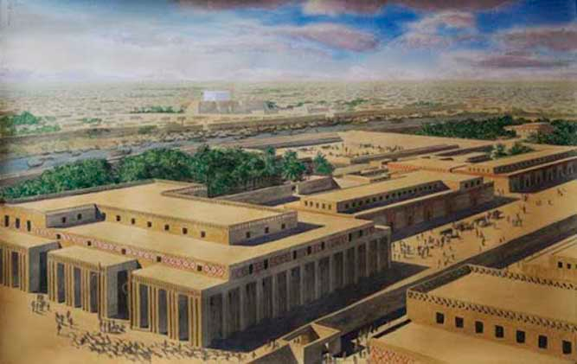
In addition to being one of the first cities, Uruk was the main force of urbanization. Uruk's agricultural surplus and large population base facilitated processes such as trade, specialization of crafts and the evolution of writing. Evidence from excavations such as extensive pottery and the earliest known tablets of writing support these events. Excavation of Uruk is highly complex because older buildings were recycled into newer ones, thus blurring the layers of different historic periods.

Slide 5
The Seals
Seal were made from hard stone, glass, or ceramics such as Egyptian faience. Many varieties of material such as hematite, obsidian, steatite, amethyst and carnelian were used to make cylinder seals, but lapis lazuli was especially popular because of the beauty of the blue stone.
A cylinder was rolled over wet clay to mark or identify clay tablets, envelopes, ceramics and bricks, and so covers an area as large as desired, an advantage over earlier stamp seals. Inscriptions were mostly carved in reverse, so as to leave a positive image on the clay with figures standing out. Some are directly carved and leave a negative imprint. While most Mesopotamian cylinder seals form an image through the use of depressions in the cylinder surface, some cylinder seals print images using raised areas on the cylinder. The former are used primarily on wet clays; the latter, sometimes referred to as roller stamps, are used to print images on cloth and other similar two dimensional surfaces. Cylinder seals are a form of impression seal, a category which includes the stamp seal and finger ring seal.
- See more at: http://www.crystalinks.com/sumercylinderseals.html#sthash.uLMy5UCz.dpuf

Slide 6
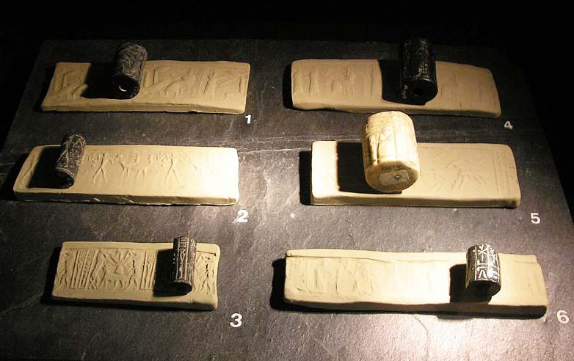
Size comparison of Seals and Impression Strips

Slide 7
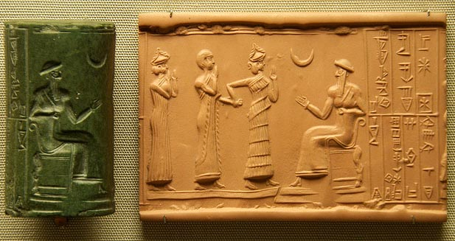
Uses of the Seals
The seals were needed as signatures, confirmation of receipts, or to mark clay tablets and building blocks
Cylinder seals identified ownership of property. They were used as administrative tool, jewelry and as magical amulets, later versions would employ notations with Mesopotamian hieroglyphs. In later periods, they were used to notarize or attest to multiple impressions of clay documents.

Slide 8
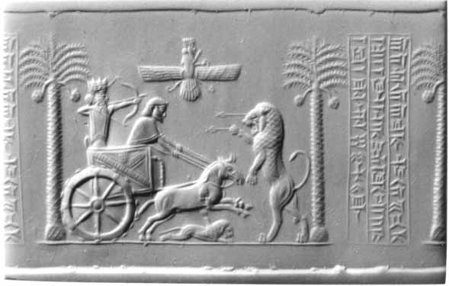
Themes of the Seals
Cylinder seals are important to historians as they often tell a story about a specific timeline and civilization. Images depicted on cylinder seals were mostly theme-driven, often sociological or religious. They presented the ideas of the society in pictographic and text form. In a famous cylinder depicting Darius I of Persia: he is aiming his drawn bow at an upright enraged lion impaled by two arrows, while his chariot horse is trampling a deceased lion.

Slide 9
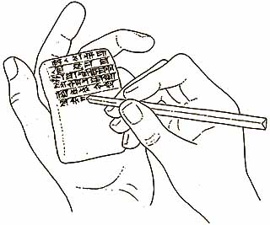
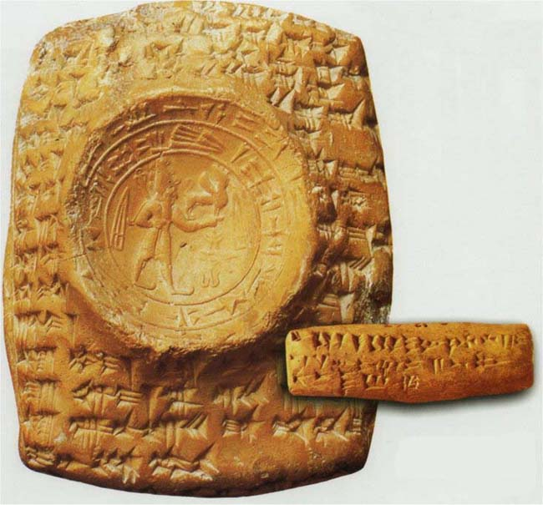
Cuneiform Tablets
Originally, pictograms were drawn on clay tablets in vertical columns with a pen made from a sharpened reed stylus, or incised in stone. This archaic style was still lacking the characteristic wedge-shape of the strokes. -
The word "cuneiform" comes from the Latin word cuneus, meaning "wedge".
Cuneiform tablets could be fired in kilns to provide a permanent record, or they could be recycled if permanence was not needed. Many of the tablets found by archaeologists were preserved because they were baked when attacking armies burned the building in which they were kept.

Slide 10
Videos and Links
The 12th planet mystery
Various cylinder seals

Slide 11
Create your own
Carve a Cuneiform Cylinder Seal
One of the most iconic artifacts from ancient Mesopotamia is
the cylinder seal. These were usually carved out of clay or
precious stone and featured a unique pattern to verify
someone's identity and “seal” important documents. Travel to
ancient Mesopotamia by carving your own
unique cuneiform cylinder seals.
What You Need:
clay
Small dish of water for re-moistening clay as needed
Sharp tool to incise the clay with (even an unfolded paper clip will work) Dentil tools work well as do loops or gouges.
Straw
Black or brown matt glaze
Kiln

Slide 12
What You Do:
1. Start with a chunk of clay about the size of a mandarin orange.
2. Roll the clay into a cylinder about the diameter of a quarter and 3-4 inches long, making it as smooth as possible.
3. If the clay gets too dry, re-moisten it with a few drops of water.
4. Using a sharp tool (like an unfolded paper clip or dentil tools), incise a design into the clay around the entire circumference of the cylinder. Remember that any letters or words must
be carved in backwards.
Skewer it with a straw to make it hollow for firing.
5. Allow the clay to dry, you can test it out by painting it with ink and rolling it across paper. You can sand or carve to perfect the image, carve your initials into the top edge. then fire it.
6. Once fired, create a slab of clay the width of the cylinder, ½ “ thick, and maybe 6 inches long.
7. Roll the cylinder across the clay slab to create an impression, dry the slab, brush it with diluted glaze, sand off the surface, and fire the slab.

